Slide 1
Architectural Exploration of Stacked DRAM Memory for Efficient LIF-based SNN Implementation
Subbaiah Ravi Hariprakash
m5282026
22/7/2025

Slide 2
Content
Introduction
Proposed Architecture
Research progress
Completed
Doing
Todo
Schedule

Slide 3
Content
Introduction
Proposed Architecture
Research progress
Completed
Doing
Todo
Schedule

Slide 4
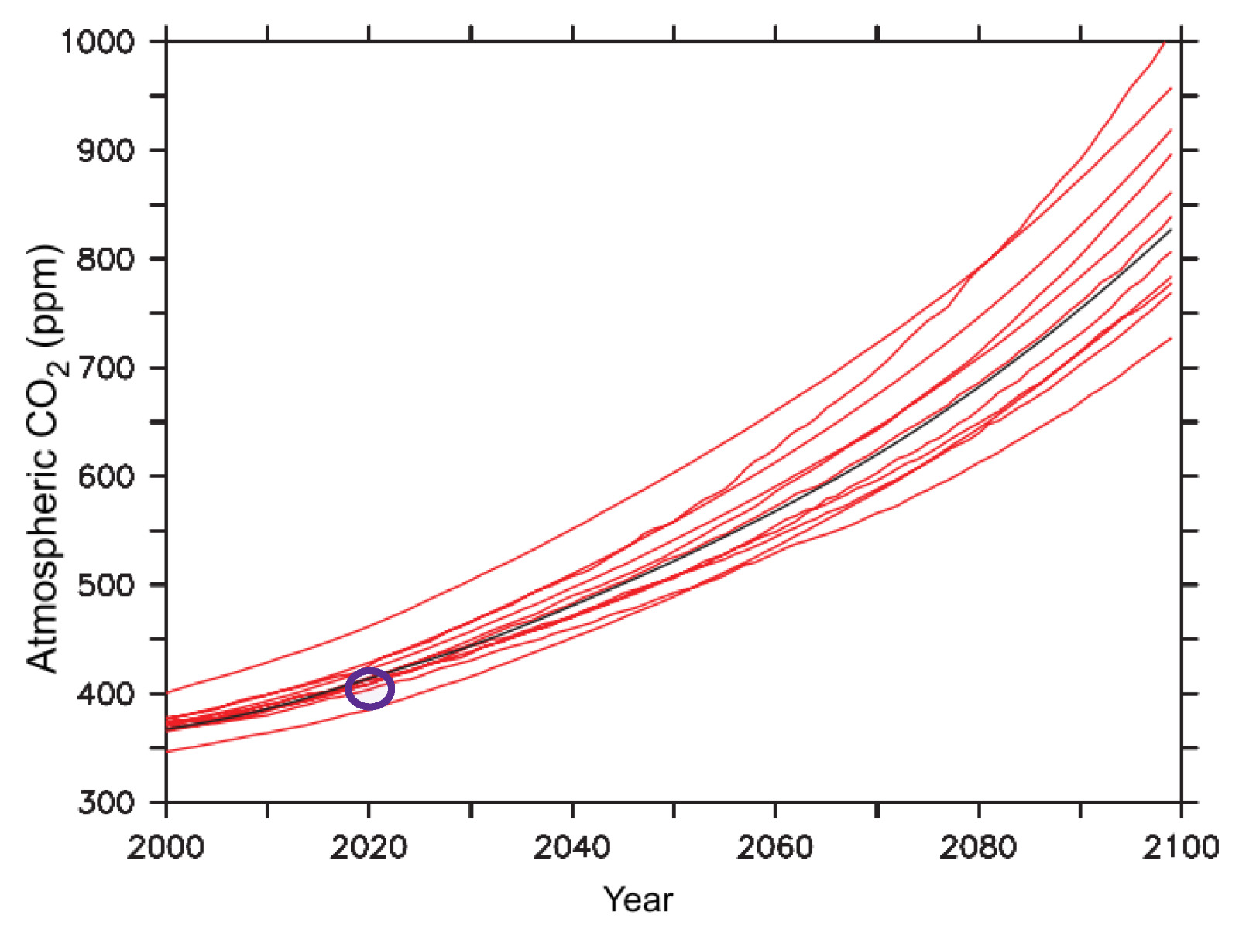


Introduction
Carbon emissions are increasing due to increased use of electronics, especially Artificial Intelligence$^{\left[8\right]}$
Fig. Predicted ${CO}_{2}$ levels

Slide 5
Content
Introduction
Proposed Architecture
Research progress
Completed
Doing
Todo
Schedule

Slide 6
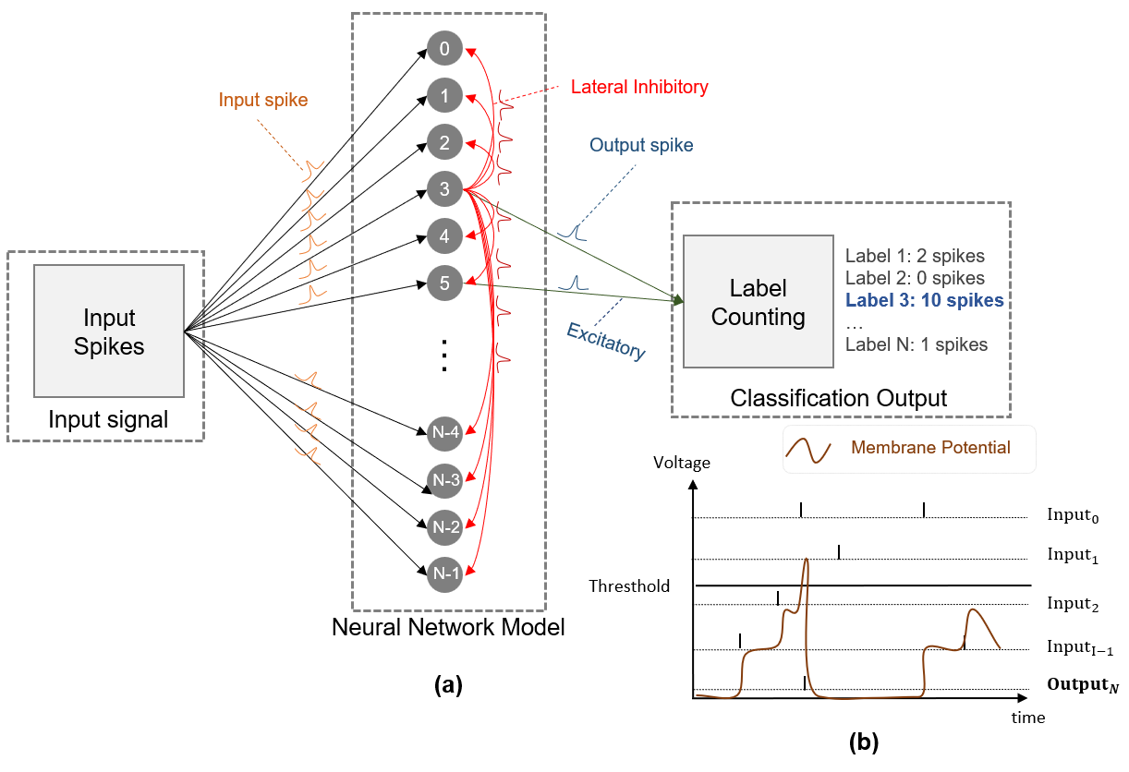
Overall Architecture
(b)
3D Stacking Memory
(c)
k^{th} Memory Die - M_{k-1}
Word line
1st Memory Die - M₀
.....
Address
Decoder
(e)
Transistor
k^{th} Memory Die
...
Bit line
TSV
.........
TSV
Capacitor
.....
.....
............
TSV
TSV
3rd Memory Die
Synapse Val.
...
2nd Memory Die
x k
Single DRAM
1st Memory Die
(d)
Synapse Crossbar
: Active
TSV
.........
TSV
.....
d₀
d₁
d₂
d_{n-1}
: Inactive
.....
Input Spike
a₀
a_{n} : Axon
.......
a₁
d_{n} : Dendrite
N
/
n
/
N
/
Logic Die
Decoder
Encoder
In. Spike
Package Substrate
/
n
...
a₂
From other
clusters
...
To other
clusters
Output Spike
a_{n-1}
m
/
Address Out.
p
p
TSV
TSV
/
/
TSV
TSV
/
m
(a)
LIF neurons
Thres.
Controller
Interface
Acc. Reg.
Refractory
STDP
Leak
...
x n

Slide 7
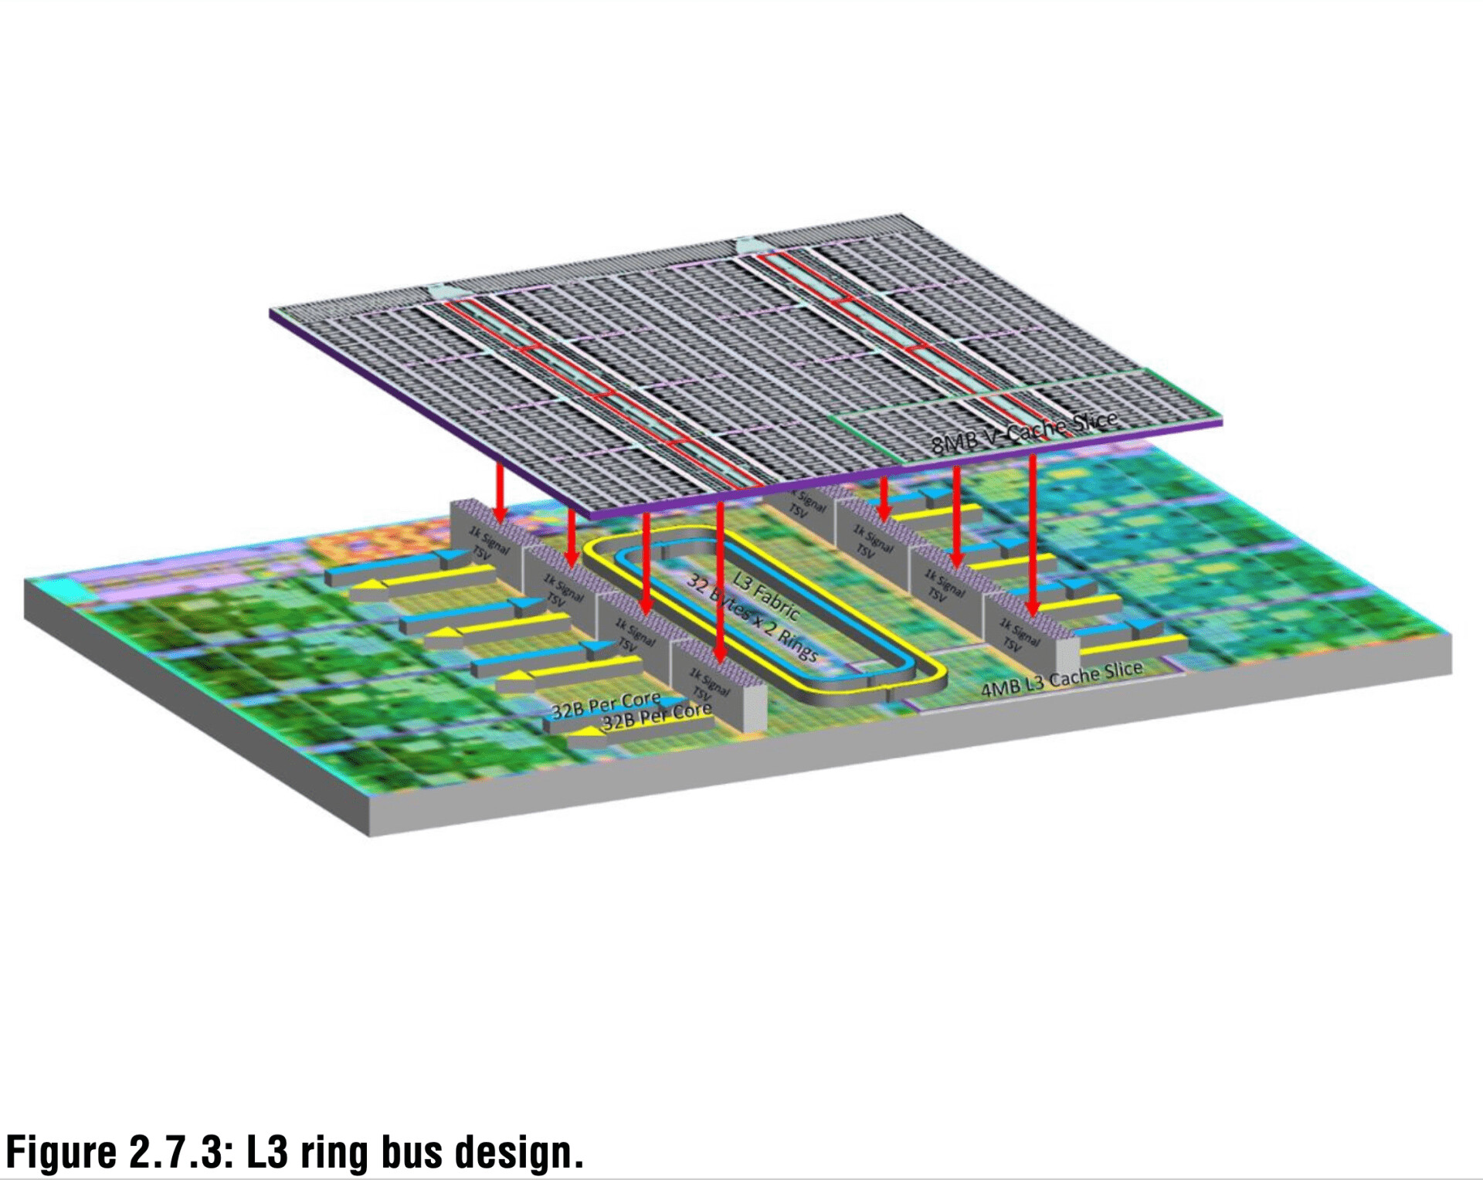
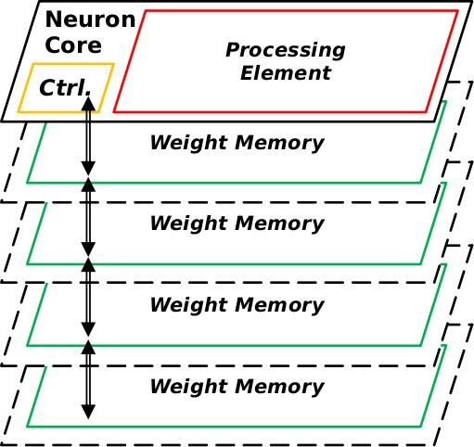
Stacking Memory
AMD’s V-Cache is a good example of stacked memory through hybrid bonding$^{[6]}$
V=1.1V
V=1.1V
V=0.7V or V=0V
Fig. AMD 3D V-Cache
V=0.7V or V=0V

Slide 8
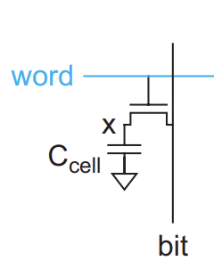
DRAM
A 1-T DRAM consists of a transistor and a capacitor
Reading:
When wordline is activated, capacitor shares charge with bitline, causing a small voltage change
Writing:
Bitline is driven to high or low
This voltage is forced onto capacitor through transistor

Slide 9
Content
Introduction
Proposed Architecture
Research progress
Completed
Doing
Todo
Schedule

Slide 10
Research Progress | Completed
The DRAM cell is implemented using HSPICE
Capacitance: 25 fF, Refreshing frequency: 15.625 Hz
Monte Carlo simulation is performed with Gaussian Variation on voltage
Relation between voltage and error is found

Slide 11
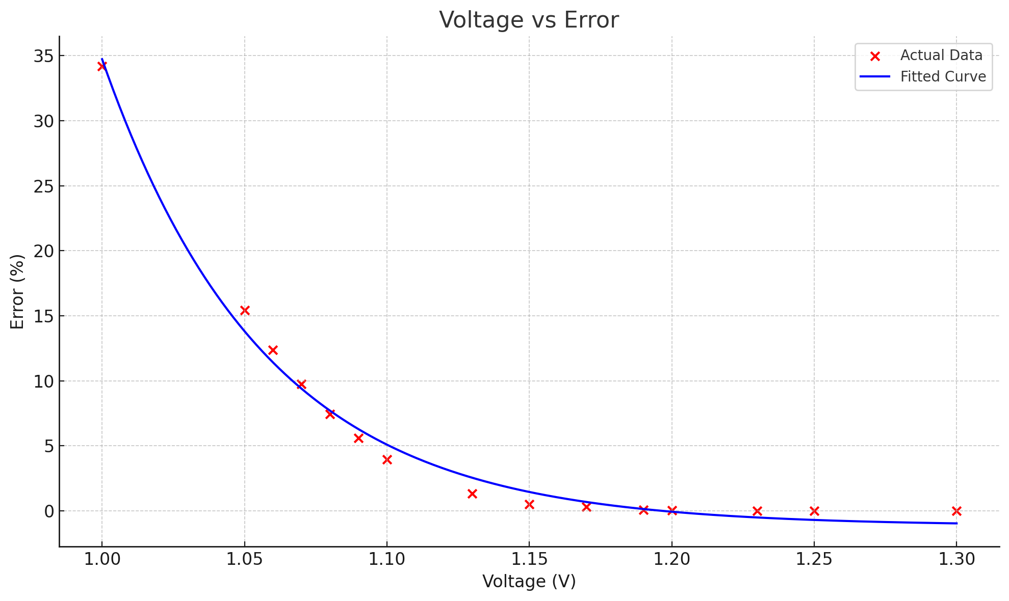

Research Progress | Completed
Where:
BER – Bit Error Rate
V - Voltage

Slide 12
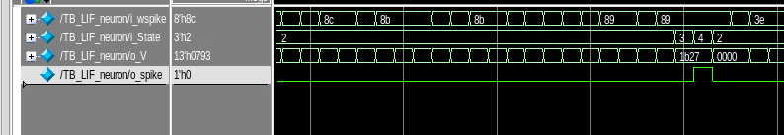
Research Progress | Completed
LIF Neuron has been executed
Notes:
Input Spike weights 8 bits:
Hex values
Neuron state:
Idle/rest = 0, Gen Spike= 2
Membrane potential:
Neuron is accumulating voltage slowly
Output spike:
Voltage hasn't reached the threshold

Slide 13
Research Progress | On-going
Found error values are being inserted in the SNN model to find new performance metrics
Architecture is being finalized

Slide 14
Research Progress | Todo
Combine all techniques and methods to maximize performance and minimize error rate
Write graduation thesis/paper

Slide 15
Content
Introduction
Proposed Architecture
Research progress
Completed
Doing
Todo
Schedule

Slide 16
Schedule
Time | July 2025 | August 2025 | … | Jan 2026
Inset new error values into SNN model
Finalize architecture
Write graduation thesis and paper
Task 1: Inset new error values into SNN model
Task 2: Finalize architecture
Task 3: Write graduation thesis and paper

Slide 17
Reference
[1] R. Kobayashi and K. N. Dang, "An Efficient Hardware Implementation of Spiking Neural Network Using Approximate Izhikevich Neuron," 2024 9th International Conference on Integrated Circuits, Design, and Verification (ICDV), Hanoi, Vietnam, 2024, pp. 13-18, doi: 10.1109/ICDV61346.2024.10616602.
[2] Ryoji Kobayashi, Ngo-Doanh Nguyen, Nguyen Anh Vu Doan and Khanh N. Dang, '’Energy-Efficient Spiking Neural Networks Using Approximate Neuron Circuits and 3D Stacking Memory’‘, 2024 IEEE 17th International Symposium on Embedded Multicore/Many-core Systems-on-Chip (MCSoC), Dec. 16-19, 2024.
[3] Du, Y. Decentralized Smart IoT. Encyclopedia. Available online: https://encyclopedia.pub/entry/8977 (accessed on 22 November 2022).
[4] S. H. Tsang, https://towardsdatascience.com/review-refinenet-multi-path-refinement- network-semantic-segmentation-5763d9da47c1
[5] John L. Hennessy, David A. Patterson, A New Golden Age for Computer Architecture, Communications of the ACM, February 2019, Vol. 62 No. 2, Pages 48-60, 10.1145/3282307
[6] J. Wuu et al., "3D V-Cache: the Implementation of a Hybrid-Bonded 64MB Stacked Cache for a 7nm x86-64 CPU," 2022 IEEE International Solid-State Circuits Conference (ISSCC), San Francisco, CA, USA, 2022, pp. 428-429, doi: 10.1109/ISSCC42614.2022.9731565. keywords: {Three-dimensional displays;Conferences;Discrete Fourier transforms;Bandwidth;Hybrid power systems;Central Processing Unit;Bonding},
[7] H. Songara and A. Deshwal, "Towards Tackling Capacity-Bound Models Using DRAMs Over SRAMs," 2024 IEEE 21st India Council International Conference (INDICON), Kharagpur, India, 2024, pp. 1-6, doi: 10.1109/INDICON63790.2024.10958400.
[8] Meng, Y., & Noman, H. (2022). Predicting CO₂ Emission Footprint Using AI through Machine Learning. Atmosphere, 13(11), 1871

Slide 18
Reference
[9] A. Ben, K. N, Dang, Neuromorphic Computing Principles and Organization, Springer, 2022
[10] F. Akopyan et al., "TrueNorth: Design and Tool Flow of a 65 mW 1 Million Neuron Programmable Neurosynaptic Chip," in IEEE Transactions on Computer-Aided Design of Integrated Circuits and Systems, vol. 34, no. 10, pp. 1537-1557, Oct. 2015, doi: 10.1109/TCAD.2015.2474396.
[11] M. Davies et al., "Loihi: A Neuromorphic Manycore Processor with On-Chip Learning," in IEEE Micro, vol. 38, no. 1, pp. 82-99, January/February 2018, doi: 10.1109/MM.2018.112130359.
[12] B. V. Benjamin et al., "Neurogrid: A Mixed-Analog-Digital Multichip System for Large-Scale Neural Simulations," in Proceedings of the IEEE, vol. 102, no. 5, pp. 699-716, May 2014, doi: 10.1109/JPROC.2014.2313565.
[13] B. Vaidyanathan, W.-L. Hung, F. Wang, Y. Xie, V. Narayanan, and M. J. Irwin, “Architecting microprocessor components in 3d design space,” in 20th International Conference on VLSI Design, 2007. Held Jointly with 6th International Conference on Embedded Systems., pp. 103–108, IEEE, 2007.
[14] N. -D. Nguyen, A. B. Ahmed, A. B. Abdallah and K. N. Dang, "Power-Aware Neuromorphic Architecture With Partial Voltage Scaling 3-D Stacking Synaptic Memory," in IEEE Transactions on Very Large Scale Integration (VLSI) Systems, vol. 31, no. 12, pp. 2016-2029, Dec. 2023, doi: 10.1109/TVLSI.2023.3318231
[15] Li, Y., Hu, Z., Choukse, E., Fonseca, R., Suh, G. E., & Gupta, U. (2025, February 7). EcoServe: Designing Carbon-Aware AI Inference Systems (arXiv preprint arXiv:2502.05043)
[16] C. Torres-Huitzil and B. Girau, "Fault and Error Tolerance in Neural Networks: A Review," in IEEE Access, vol. 5, pp. 17322-17341, 2017, doi: 10.1109/ACCESS.2017.2742698.

Slide 19
Thank you for your attention!

